Slide 1
PPI notes deck
SJ Kim
6/20/23

Slide 2
UniProtKB
Look at 4 examples of yeast proteins from UniProt that have both binary and multiple interactions
See if the api call can pull the pubmedID’s associated specifically with the interaction (as evidence)

Slide 3
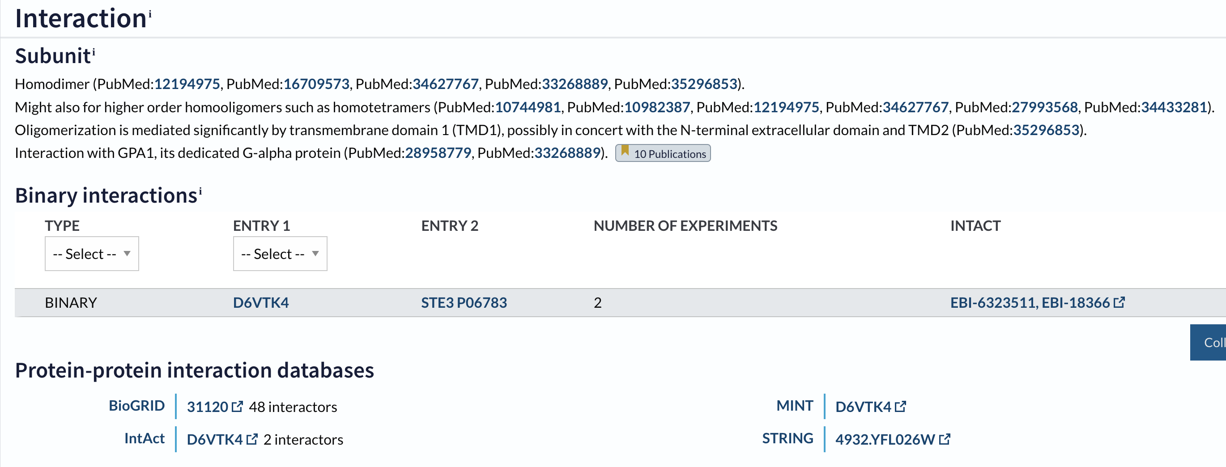
UniProtKB Protein Interaction info
Example 1 of binary interaction:
Entry: D6VTK4, Entry name: STE2_Yeast

Slide 4
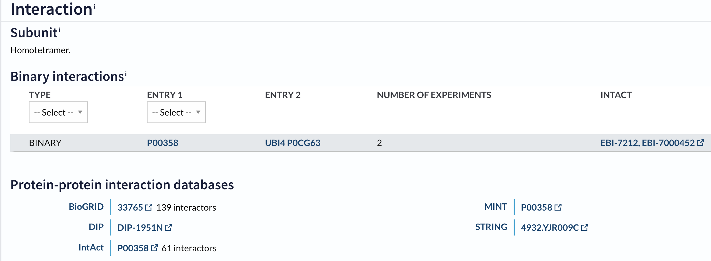
UniProtKB Protein Interaction info
Example 2 of binary interaction:
P00358 G3P2_Yeast

Slide 5
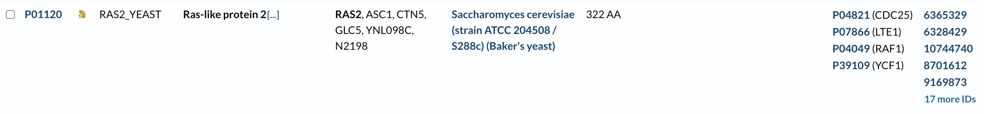
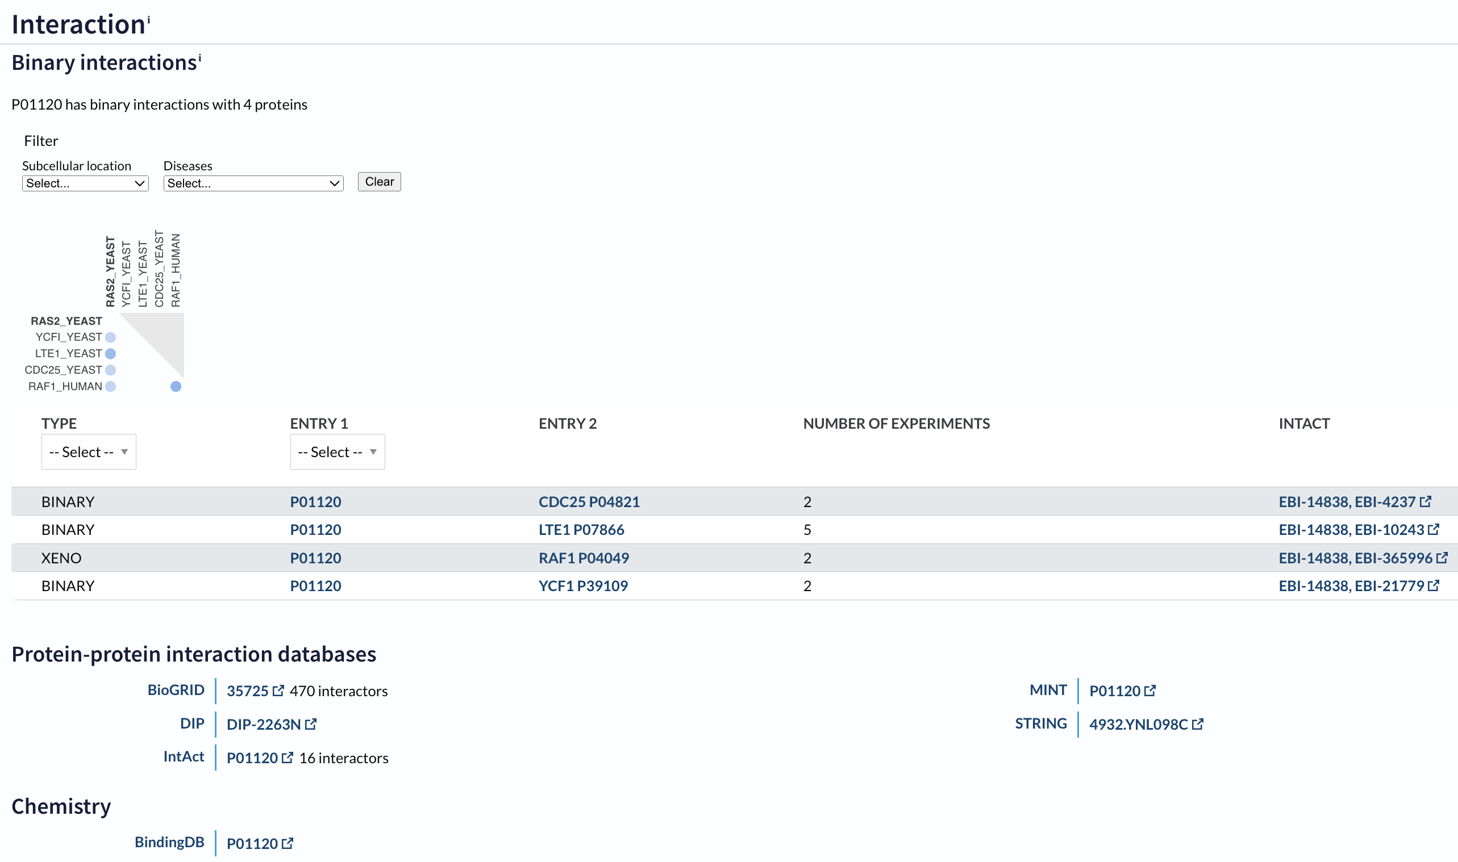
UniProtKB Protein Interaction Info
Example 1 of multiple interactions:

Slide 6
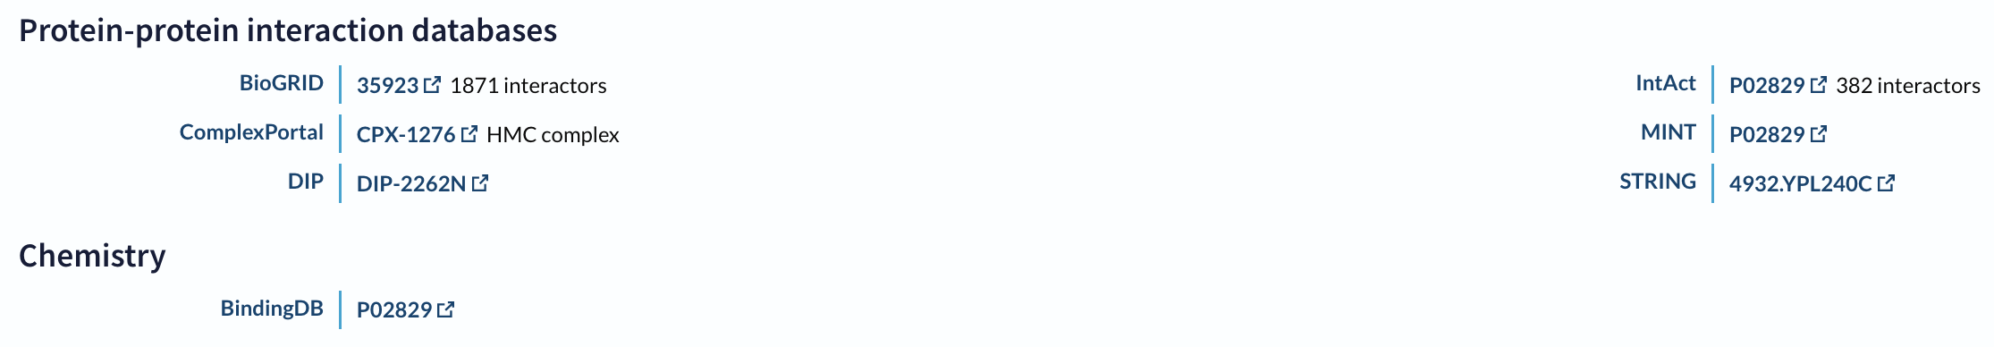
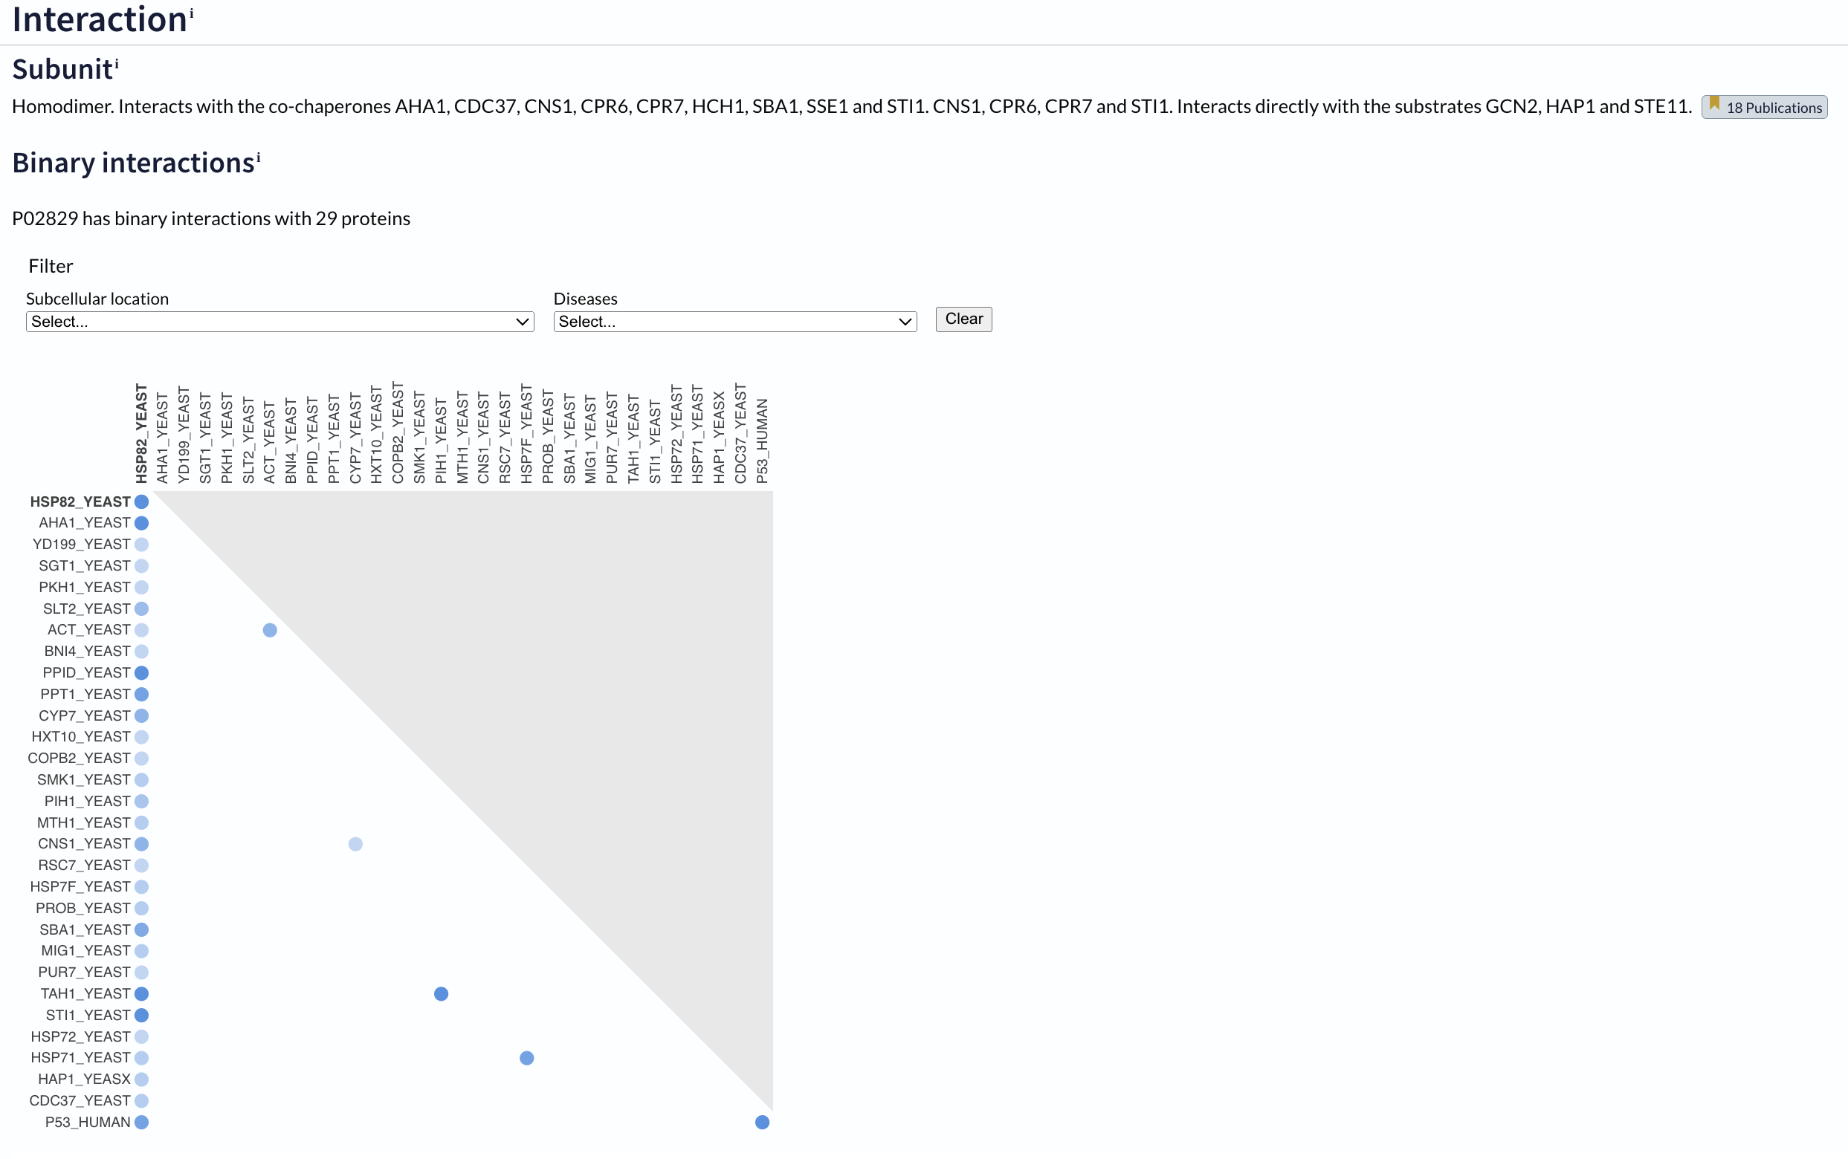
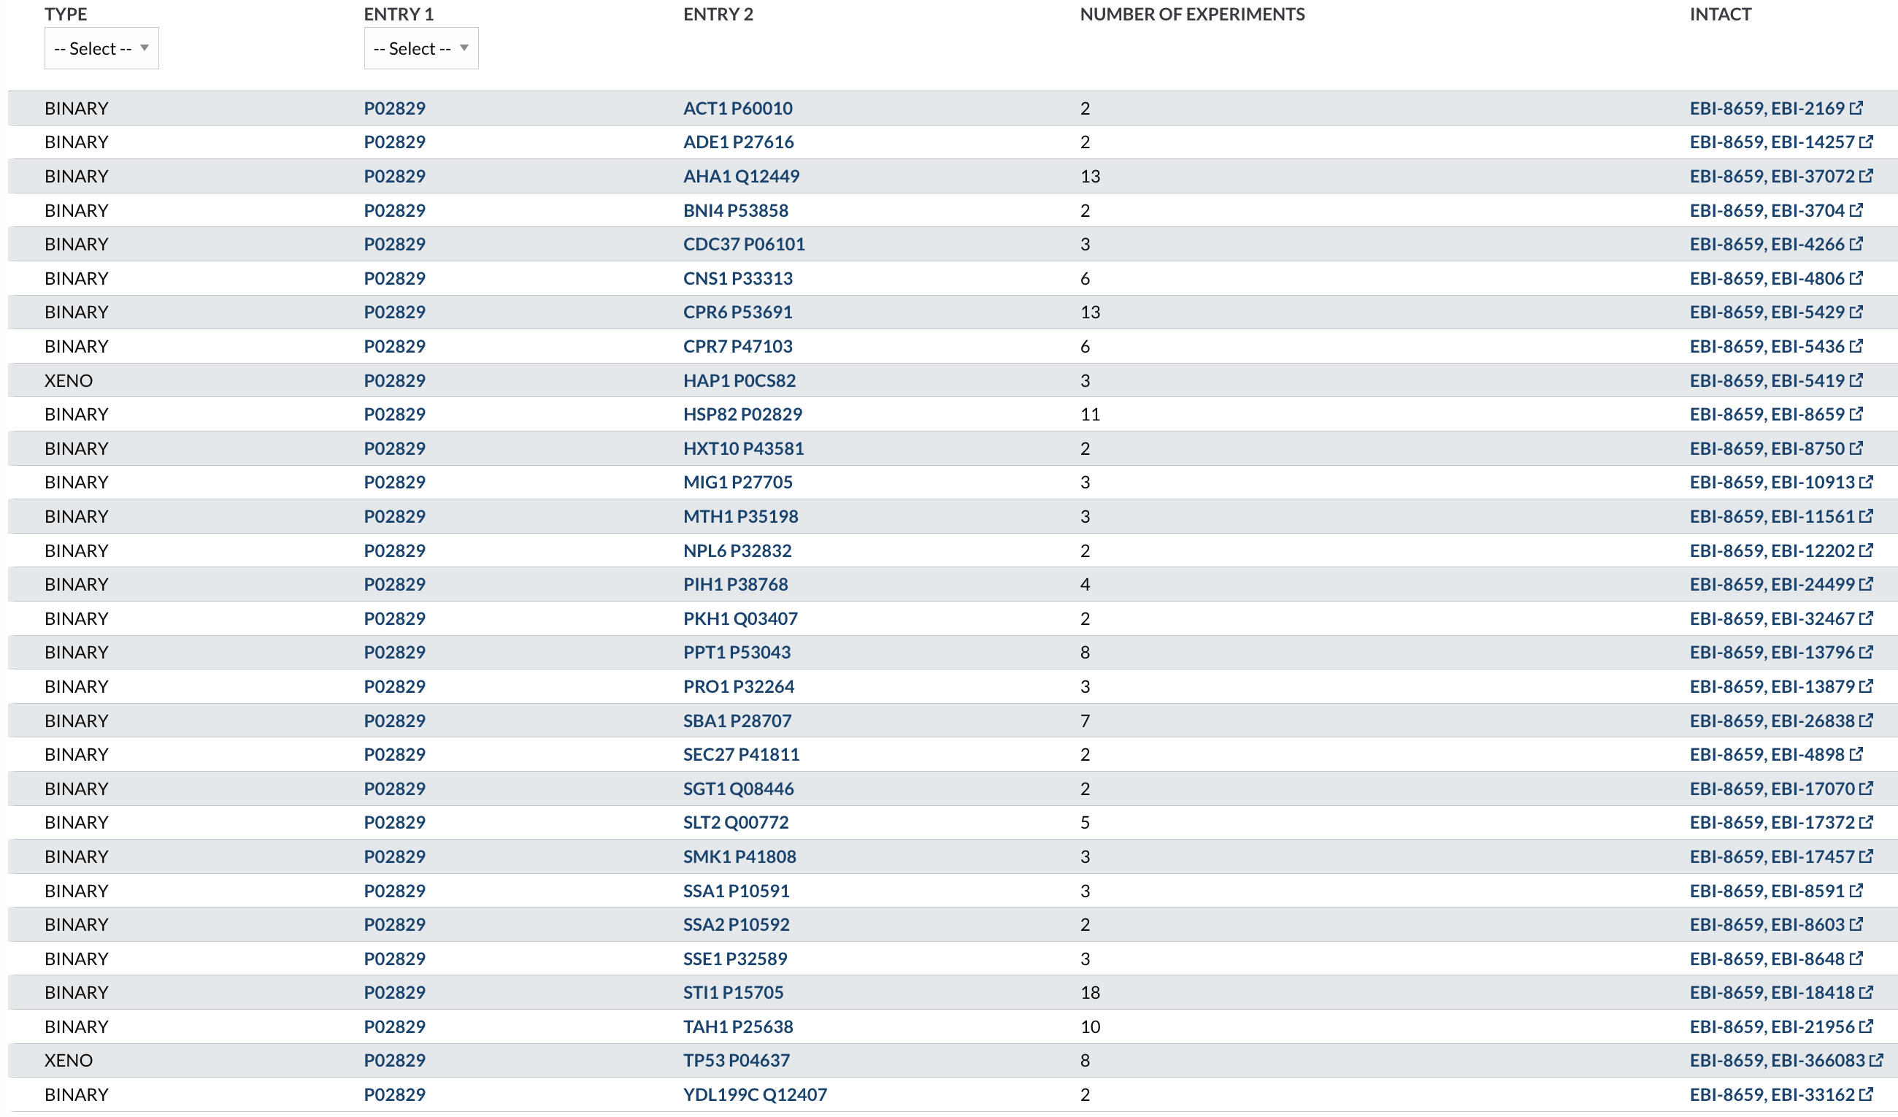
UniProtKB Protein Interaction Info
Example 2 of multiple interactions:

Slide 7
UniProtKB
Look at one yeast protein (GMC2), look at the listed binary interactions, and check the sources
Compare/contrast the sources and what they list as binary interaction

Slide 8
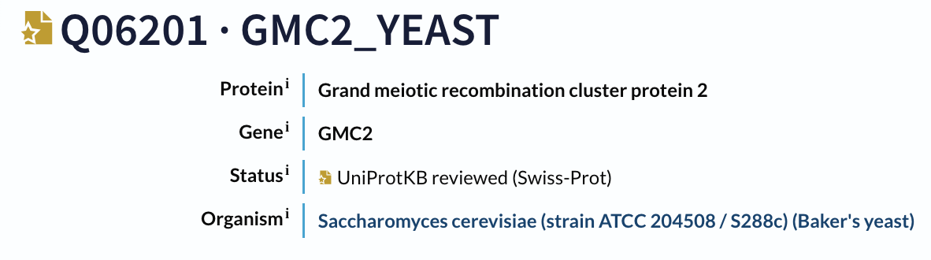
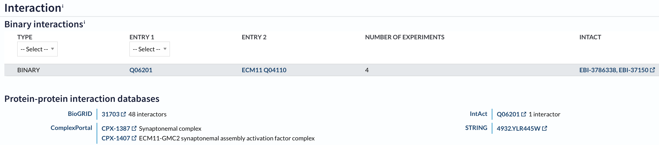
UniProtKB Protein Interaction Info
Q06201 has 1 listed binary interaction with ECM11 (Q04110) in UniProtKB
Evidence is cited from 4 sources: BioGRID, ComplexPortal, IntAct, and STRING

Slide 9
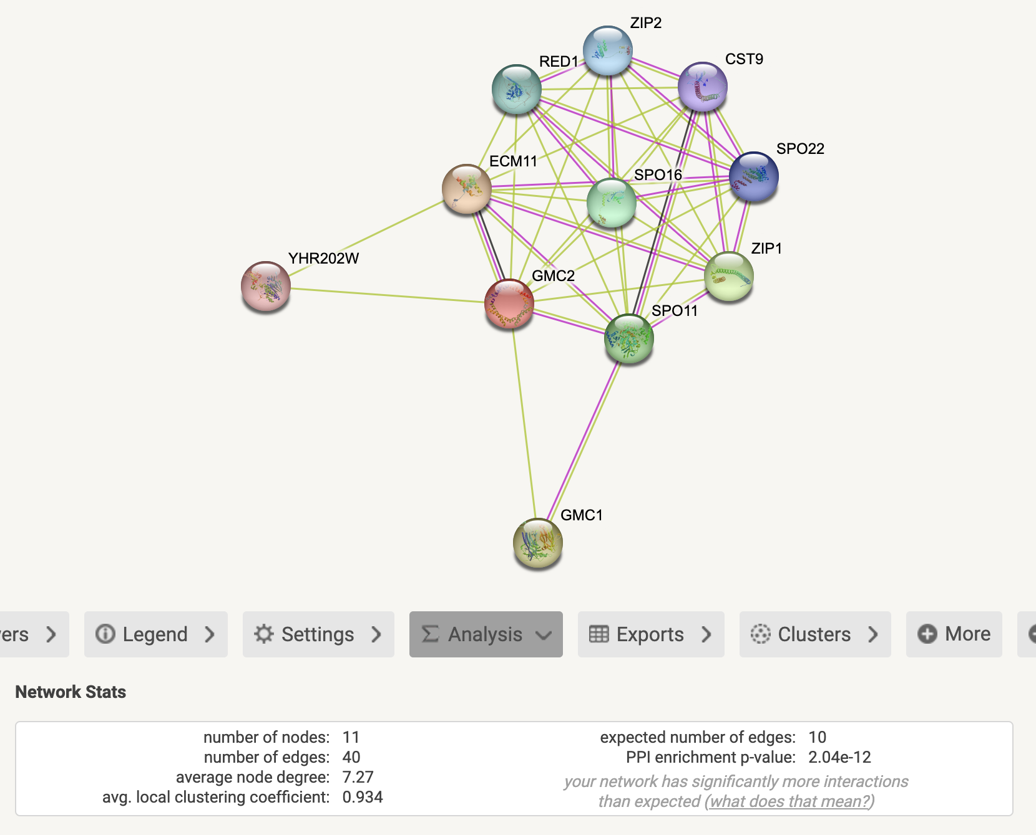
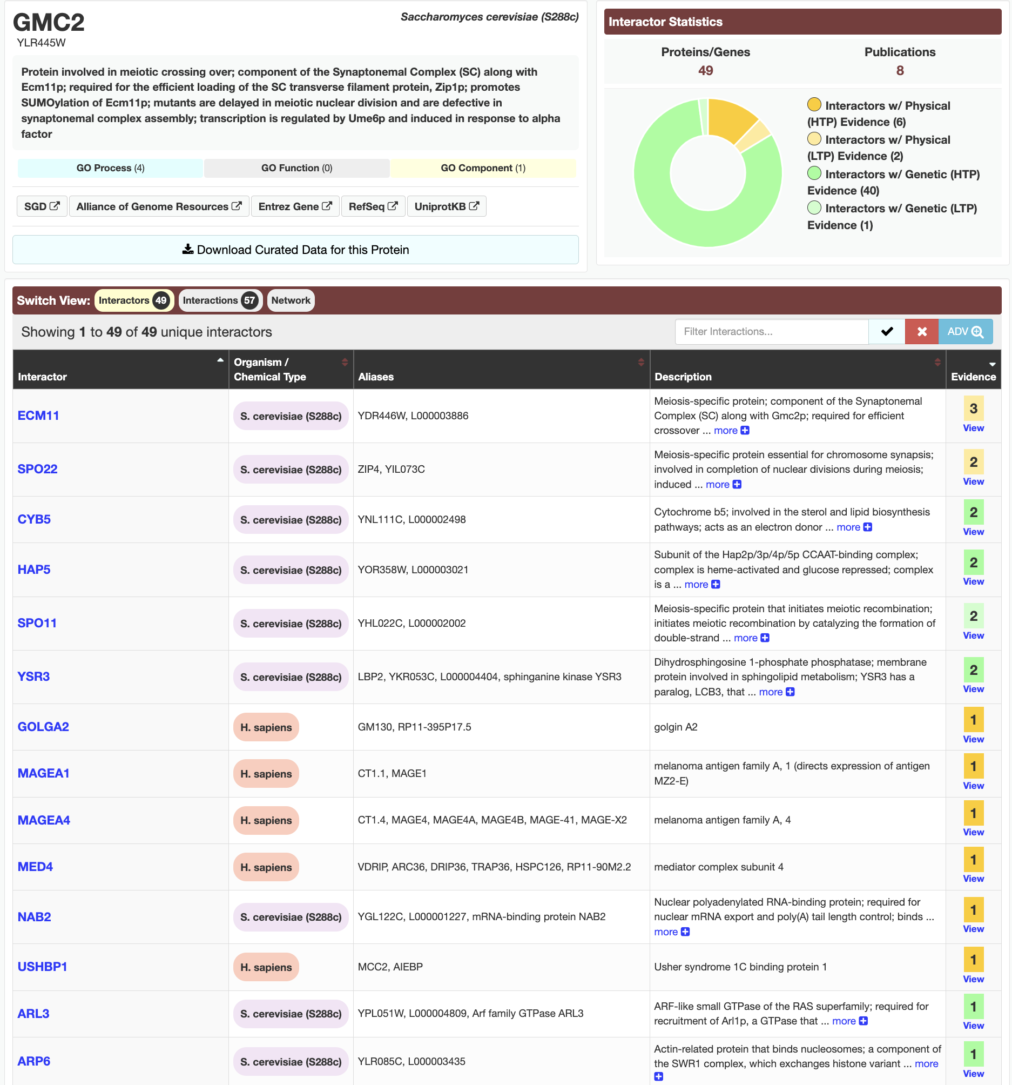
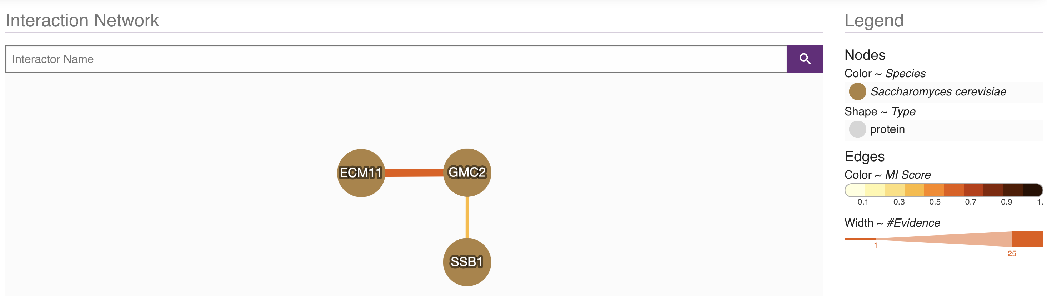
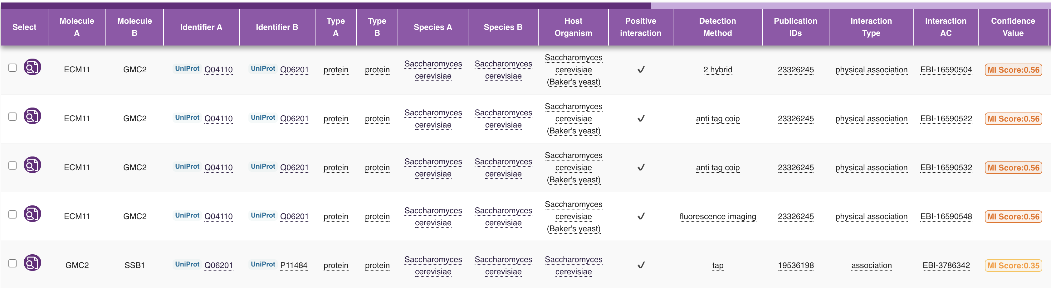
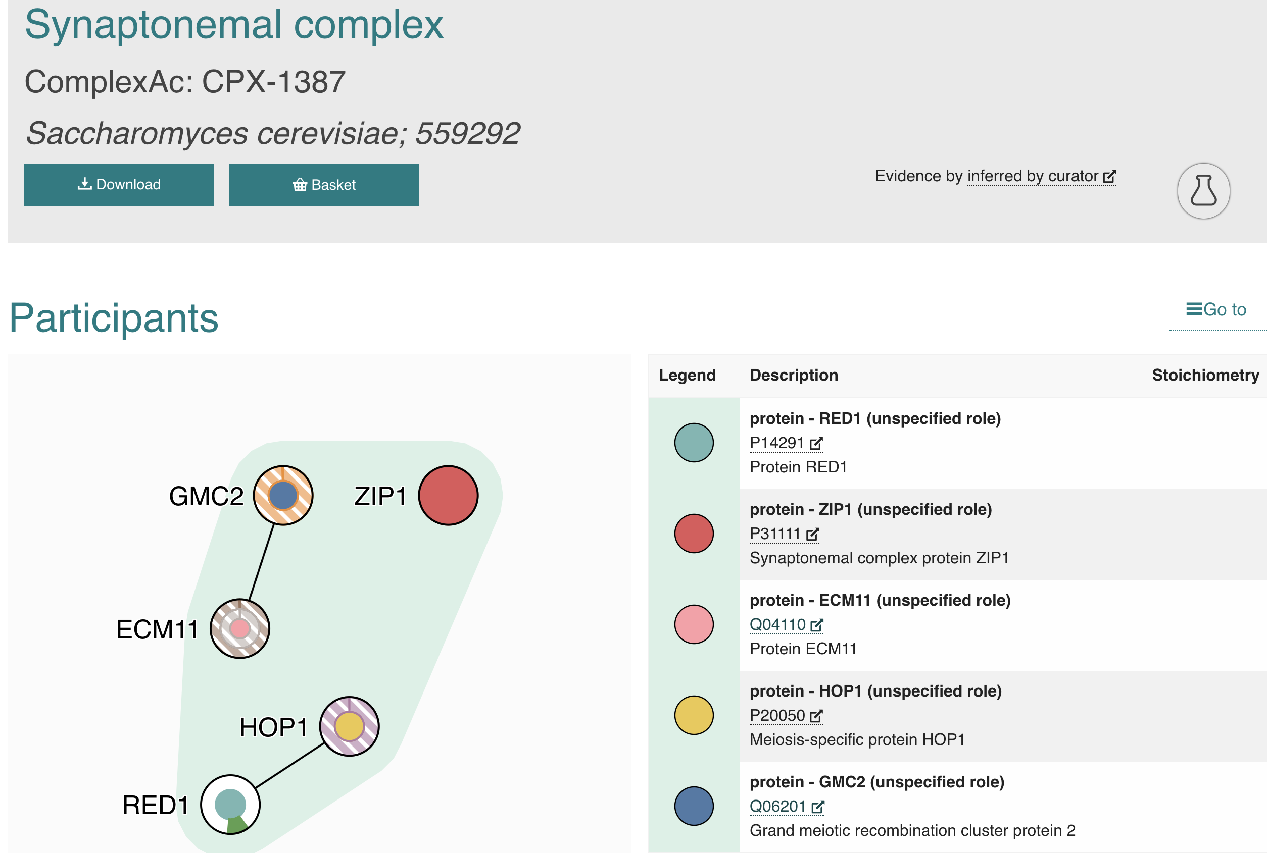
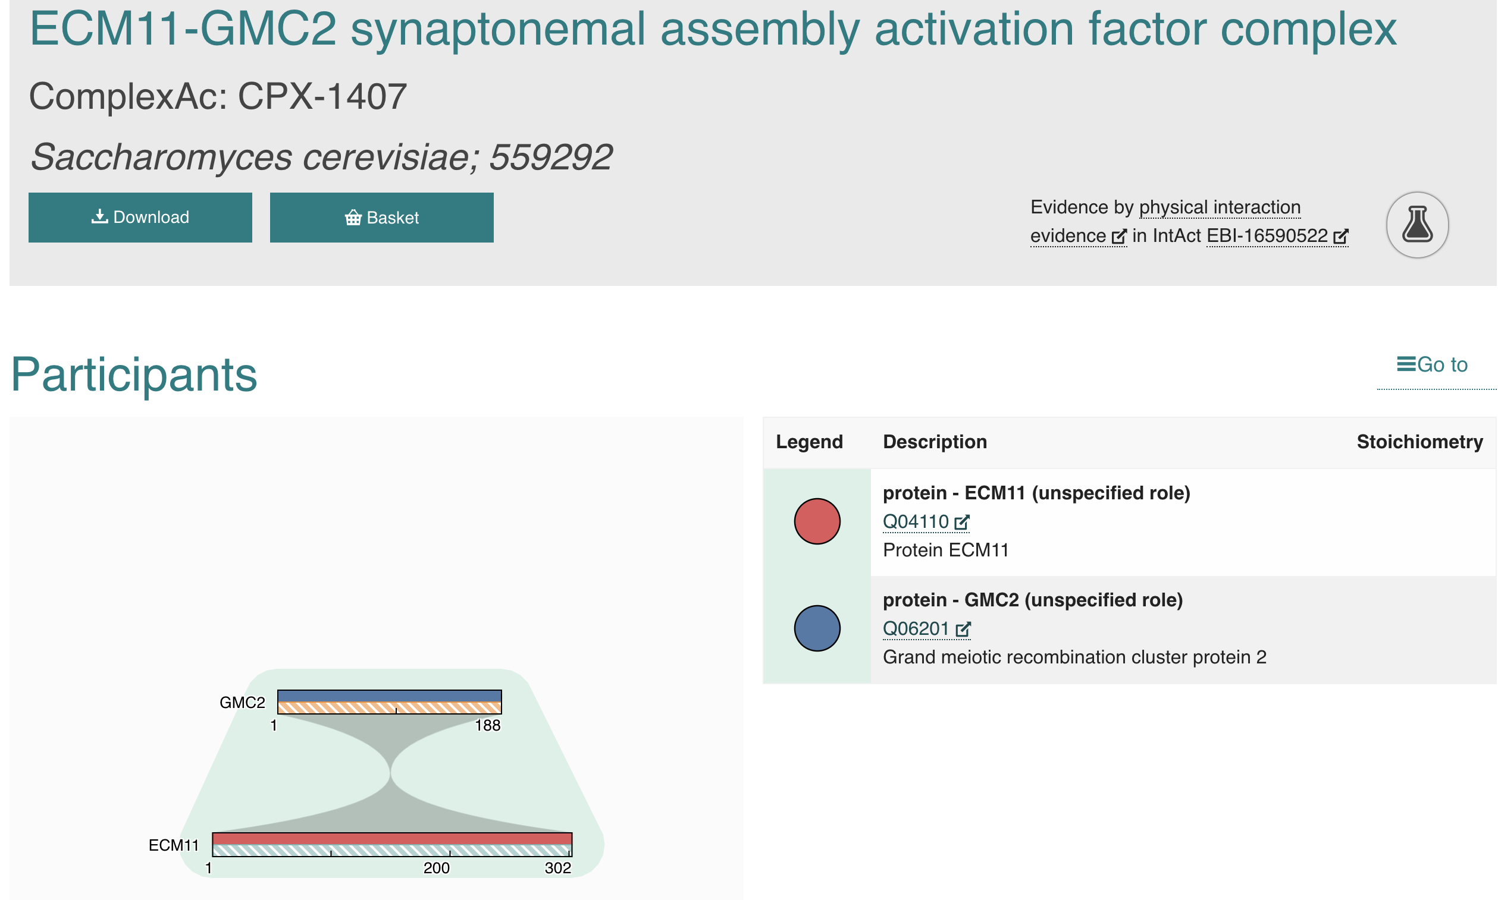
Comparing PPI Database Results for Q06201 (GMC2_Yeast)
BioGRID:
48 interactors
IntAct:
2 unique interactors
STRING: 10 interactors
ComplexPortal:

Slide 10
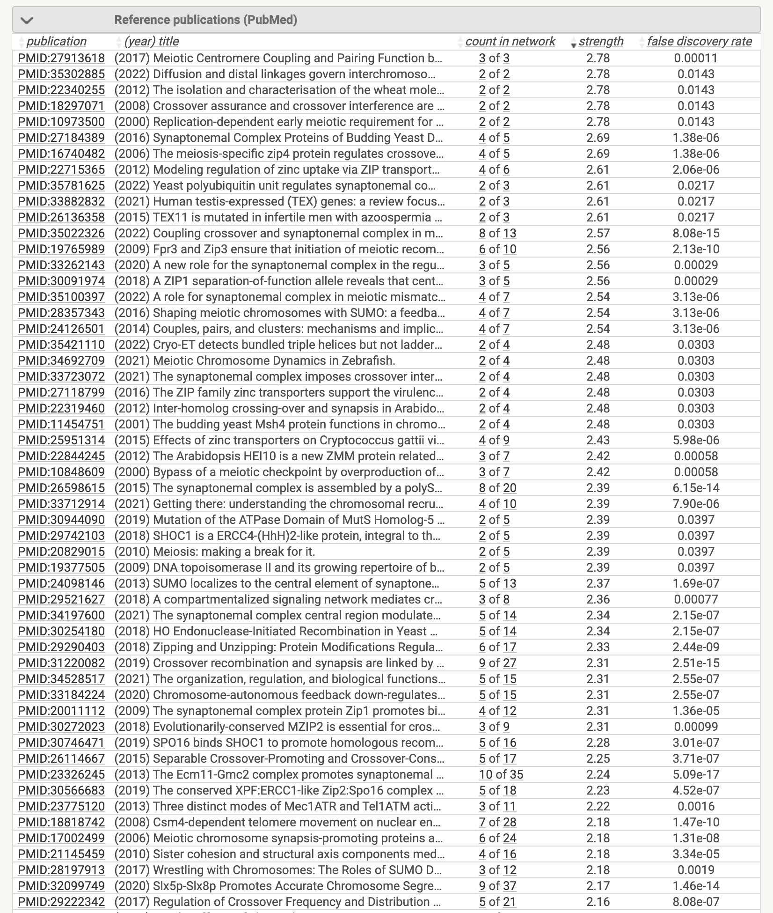
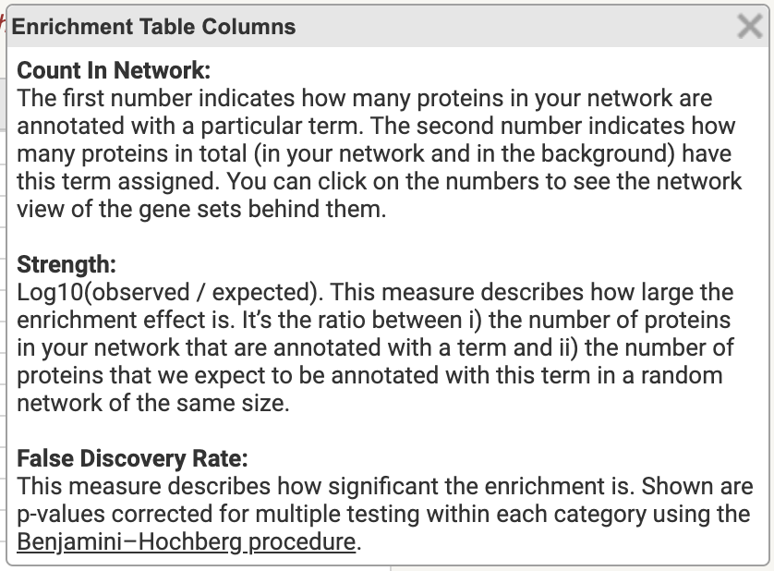
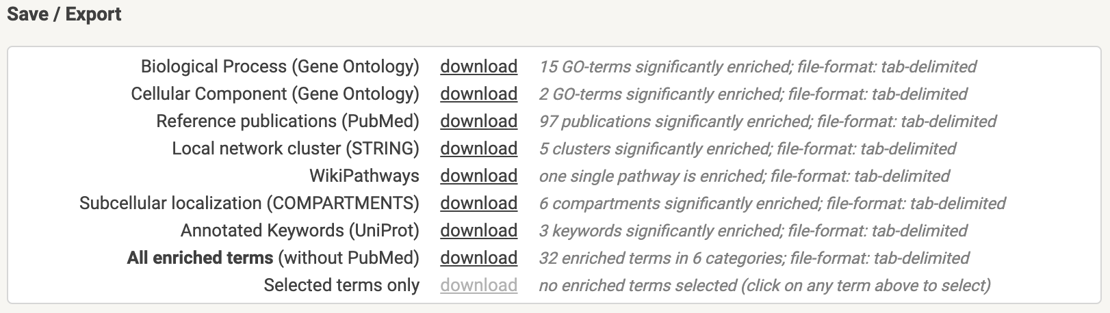
STRING Scores

Slide 11
Comparing PPI Database Results for Q06201 (GMC2_Yeast)
BioGRID:
48 interactors
IntAct:
2 interactors
STRING:
10 interactors
ComplexPortal:
4 interactors
ECM11 (yeast)
SPO22 (yeast)
CYB5 (yeast)
HAP5 (yeast)
SPO11 (yeast)
YSR3 (yeast)
GOLGA2 (human)
MAGEA1 (human)
MAGEA4 (human)
MED4 (human)
NAB2 (yeast)
USHBP1 (human)
ARL3 (yeast)
ARP6 (yeast)
ECM11
SSB1
ECM11
YHR202W
GMC1
SPO11
ZIP1
SPO16
RED1
ZIP2
CST9
SPO22
ECM11
RED1
HOP1
ZIP1
NOTE:
UniProt pulls from other PPI databases, these four were shown as an example.
Other PPI databases: DIP, MINT

Slide 12
PPI Programmatic Access Breakdown
 | IntAct | STRING | BioGRID | ComplexPortal
Is PPI info programmatically accessible? | Yes | Yes
How? | Unless someone can figure out the API call (which doesn't seem to fit our use case), we can use a wget command to pull a species database, and then write a script to filter the xml files down. | Interaction data can be downloaded by organism thru their Downloads page. API as well for specific information.
Difficulty | Few weeks of effort to write script. Pretty difficult | Medium difficulty – lots of documentation available

Slide 13
UniProtKB, IntAct, STRING?
UniProtKB seems to be using IntAct as their source by listing only what’s from IntAct on UniProt’s website https://www.uniprot.org/help/binary_interactions
Quality check IntAct to make sure there isn’t a “predictions” set – we want experimentally elucidated information only
What is the curation process and standard?
Check IntAct coverage – list of organisms specified in emails + from David
Try pulling via api from STRING since pulling from IntAct is a pain

Slide 14
IntAct Curation Process
IntAct is part of the International Molecular Exchange (IMEx) Consortium, formed in 2005, to set an international standard for protein-protein interactions
Groups within IMEx: IntAct, MINT, DIP, UniProt, MatrixDB, InnateDB, HPIDB, UCL functional gene annotation team, IID
curates published, experimentally derived interaction data
Maps interaction data to a limited set of defined molecular identifiers
Controlled Vocabulary (CV) https://www.ebi.ac.uk/ols/ontologies/mi
IMEx Consortium PPI definition: Protein-protein complex, protein-small molecule, protein-carbohydrate, protein-nucleic acid, nucleic acid-nucleic acid interactions
Binary interaction?
https://www.nature.com/articles/s41467-020-19942-z (2020)

Slide 15

IntAct Species Coverage:
Pavlo B.
Synechococcus elongatus PCC7942 - cyanobacteria to fox CO2
Azotobacter vinelandii DJ - nitrogen fixing bacteria
Rhodosporidium toruloides IFO0880 – yeast biofactory
Pseudomonas putida kt2440
Ryan M.
Tong Z. and Amy S.
Lung immortalized cell lines from human: A549, MRC5
Immortalized human liver cells: Huh7
Primary human lung epithelial cells
Microbacterium oxydans - Member of our Carb Stor Community and does not produce CaCO3
Rhodococcus qingshengii – Member of our Carb Stor Community and produces CaCO3
Bacillus thuringiensis - Member of our Carb Stor Community and does not produce CaCO3
Bacillus toyonensis - Member of our Carb Stor Community and likely produces CaCO3
Curtobacterium flaccumfaciens - Member of our Carb Stor Community and does not produce CaCO3
Sporosarcina pasteurii – Positive control organism that is a known CaCO3 producer

